Slide 1
Machine Learning
Logistic Regression
Winter 2012

Slide 2
Logistic regression
Name is somewhat misleading. Really a technique for classification, not regression.
– “Regression” comes from fact that we fit a linear model to the feature space.
Involves a more probabilistic view of classification.
Winter 2012

Slide 3
Different ways of expressing probability
Consider a two-outcome probability space, where:
– p( O₁ ) = p
– p( O₂ ) = 1 – p = q
Can express probability of O₁ as:
 | notation | range |  | equivalents
standard probability | p | 0 | 0.5 |  | 1
odds | p / q | 0 | 1 |  | + ∞
log odds (logit) | log( p / q ) | - ∞ | 0 |  | + ∞
Winter 2012

Slide 4
Log odds
Numeric treatment of outcomes O₁ and O₂ is equivalent
If neither outcome is favored over the other, then log odds = 0.
If one outcome is favored with log odds = x, then other outcome is disfavored with log odds = -x.
Especially useful in domains where relative probabilities can be miniscule
Example: multiple sequence alignment in computational biology
Winter 2012

Slide 5
From probability to log odds (and back again)
⎛ p
⎞
z = log⎜ ⎟
1− p
logit function
⎝
⎠
p
= e^{z}
1− p
_{e}z
1
1+ e^{z} 1+ e^{− z}
p =
=
logistic function
Winter 2012

Slide 6


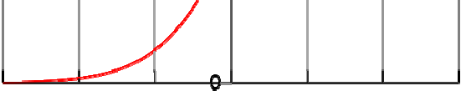
Standard logistic function
Winter 2012

Slide 7
Logistic regression
Scenario:
A multidimensional feature space (features can be categorical or continuous).
Outcome is discrete, not continuous.
We’ll focus on case of two classes.
It seems plausible that a linear decision boundary (hyperplane) will give good predictive accuracy.
Winter 2012

Slide 8
Using a logistic regression model
Model consists of a vector β in d-dimensional feature space
For a point x in feature space, project it onto β to convert it into a real number z in the range - ∞ to + ∞
z = α + β ⋅ x = α + β₁ x₁ +L+ β_{d} x_{d}
Map z to the range 0 to 1 using the logistic function
p = 1/(1+ e^{− z} )
Overall, logistic regression maps a point x in d- dimensional feature space to a value in the range 0 to 1
Winter 2012

Slide 9
Using a logistic regression model
Can interpret prediction from a logistic regression model as:
A probability of class membership
A class assignment, by applying threshold to probability
threshold represents decision boundary in feature space
Winter 2012

Slide 10
Training a logistic regression model
Need to optimize β so the model gives the best possible reproduction of training set labels
Usually done by numerical approximation of maximum likelihood
On really large datasets, may use stochastic gradient descent
Winter 2012

Slide 11
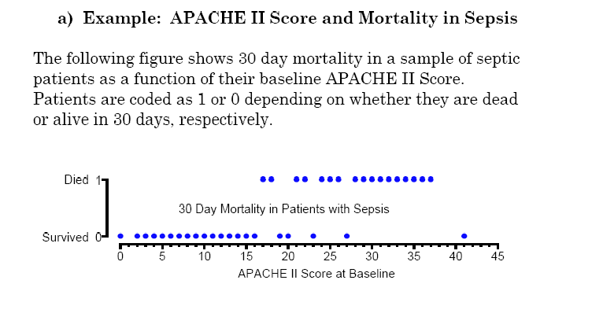
Logistic regression in one dimension
Winter 2012

Slide 12
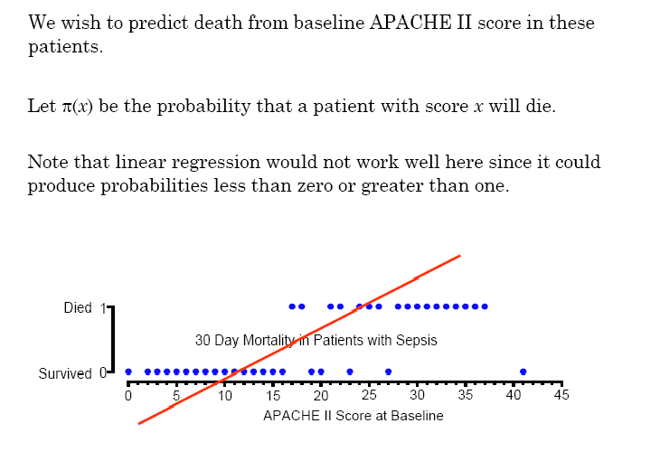
Logistic regression in one dimension
Winter 2012

Slide 13
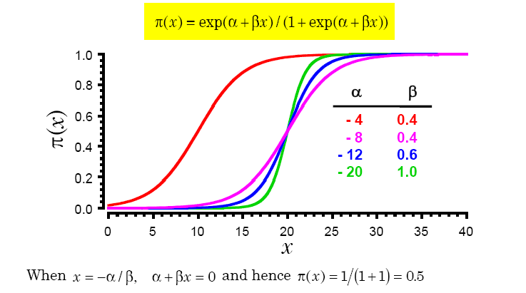
Logistic regression in one dimension
Parameters control shape and location of sigmoid curve
α controls location of midpoint
β controls slope of rise
Winter 2012

Slide 14
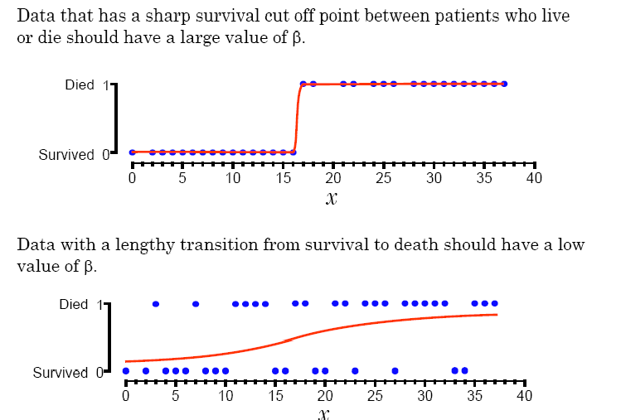
Logistic regression in one dimension
Winter 2012

Slide 15
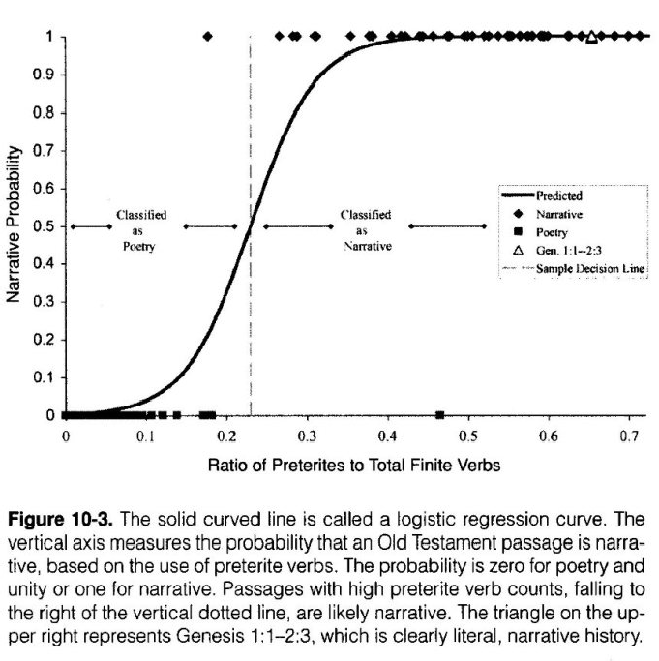
Logistic regression in one dimension
Winter 2012

Slide 16
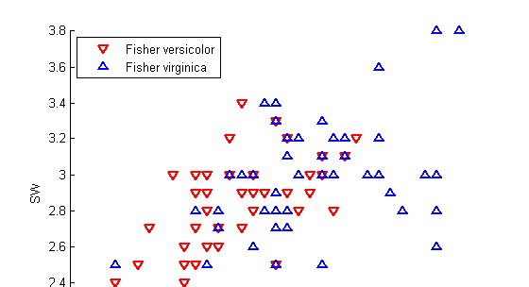
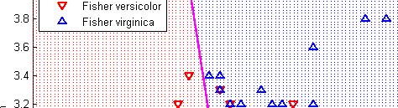
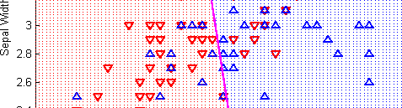
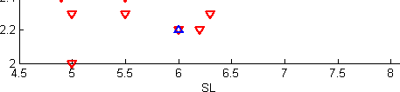
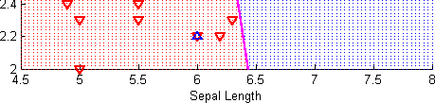
Logistic regression in two dimensions
Subset of Fisher iris dataset
Two classes
First two columns (SL, SW)
decision boundary
Winter 2012

Slide 17
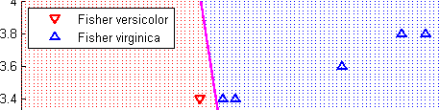
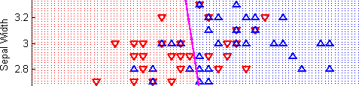
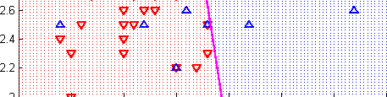
Logistic regression in two dimensions
Interpreting the model vector of coefficients
From MATLAB: B = [ 13.0460
α = B( 1 ), β = [ β₁ β₂ ] = B( 2 : 3 )
α, β define location and orientation of decision boundary
-1.9024
-0.4047 ]
- α is distance of decision boundary from origin
decision boundary is perpendicular to β
β
magnitude of β defines gradient of probabilities between 0 and 1
Winter 2012

Slide 18
Heart disease dataset
13 attributes (see heart.docx for details)
2 demographic (age, gender)
11 clinical measures of cardiovascular status and performance
2 classes: absence ( 1 ) or presence ( 2 ) of heart disease
270 samples
Dataset taken from UC Irvine Machine Learning Repository: http://archive.ics.uci.edu/ml/datasets/Statlog+(Heart)
Preformatted for MATLAB as heart.mat.
Winter 2012

Slide 19
MATLAB interlude
matlab_demo_05.m
Winter 2012

Slide 20
Logistic regression
Advantages:
Makes no assumptions about distributions of classes in feature space
Easily extended to multiple classes (multinomial regression)
Natural probabilistic view of class predictions
Quick to train
Very fast at classifying unknown records
Good accuracy for many simple data sets
Resistant to overfitting
Can interpret model coefficients as indicators of feature importance
Disadvantages:
Linear decision boundary
Winter 2012

